Slide 1
Configurations of Inhibitory Gamma Synapses

Slide 2
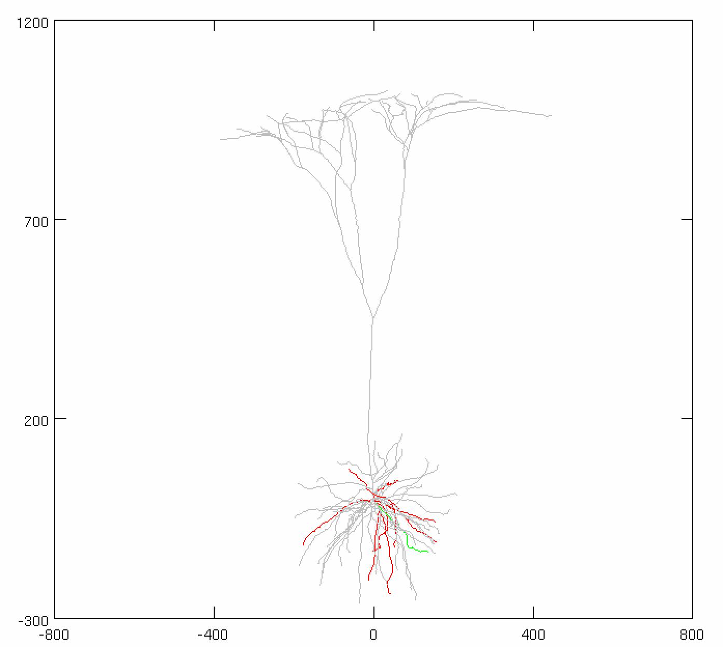
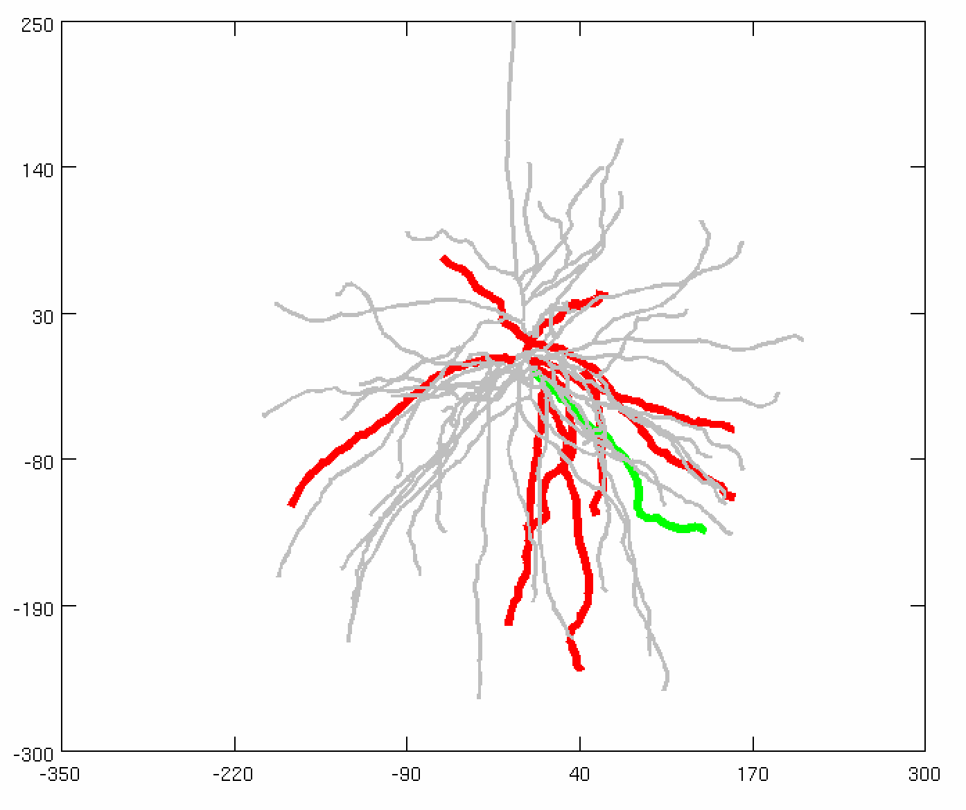
Stimulus Synapses
Total synapses: 40 synapses
AMPA: 0.0015 µS
NMDA: 0.0039 µS
Firing rate: 50 Hz
Start Time: 0 ms
Noise: 0 ms
Location: Focused at 50% of the dendrite (synchronous)
AVG: 15 trials
Background Inhibitory Synapses
Total synapses: 30 synapses
Firing rate: 50 Hz
Distribution: 3 ms
Conductance: 0.005 µS
Adjusted Current
Amplitude: Variable
Noise: 0 nA

Slide 3
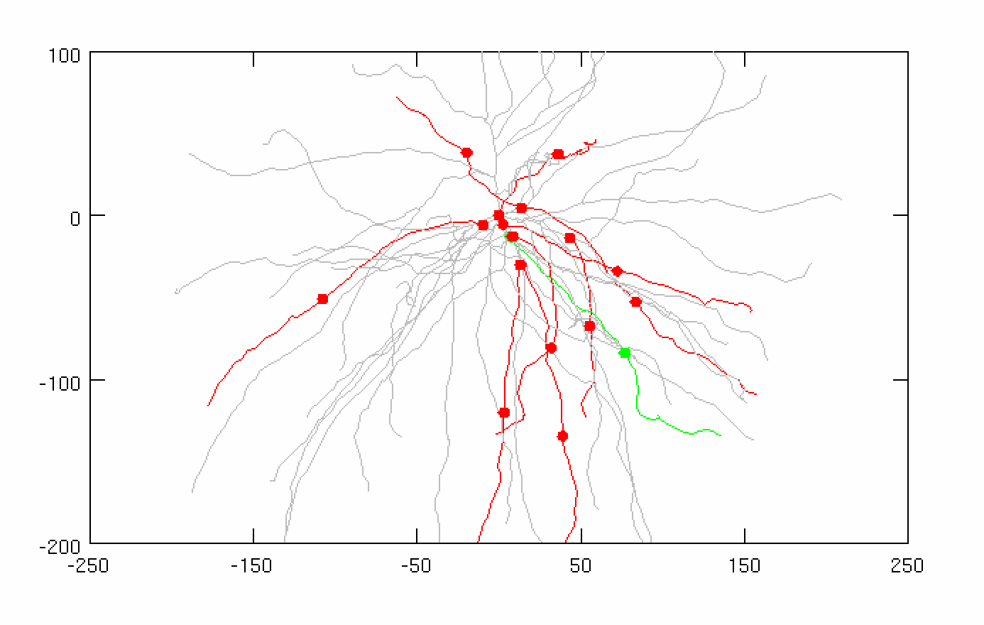
CASE 1: ½ Synapses on Soma, ½ Synapses at Excitatory Distance (139 µm)
Background Inhibitory Synapses
Total synapses: 30 synapses
Firing rate: 50 Hz
Distribution: 3 ms
Conductance: 0.005 µS
Adjusted Current
Amplitude: 1.475 nA
Noise: 0 nA

Slide 4
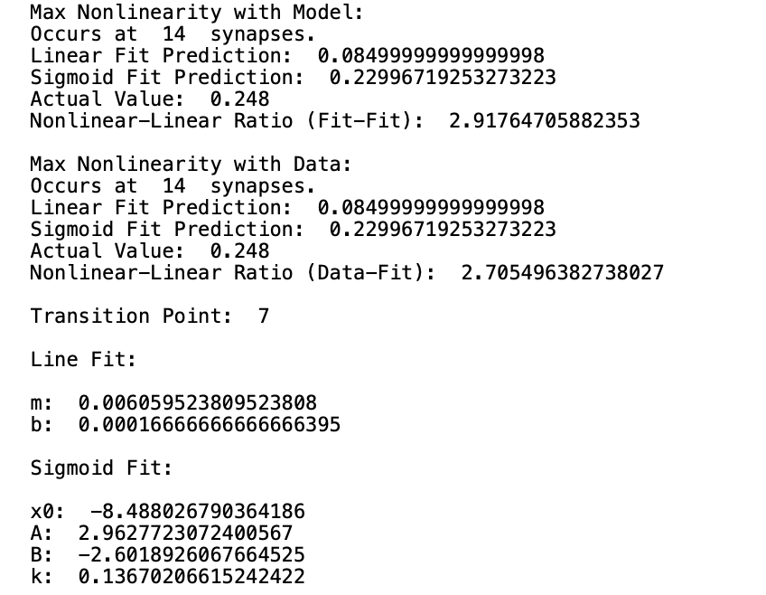
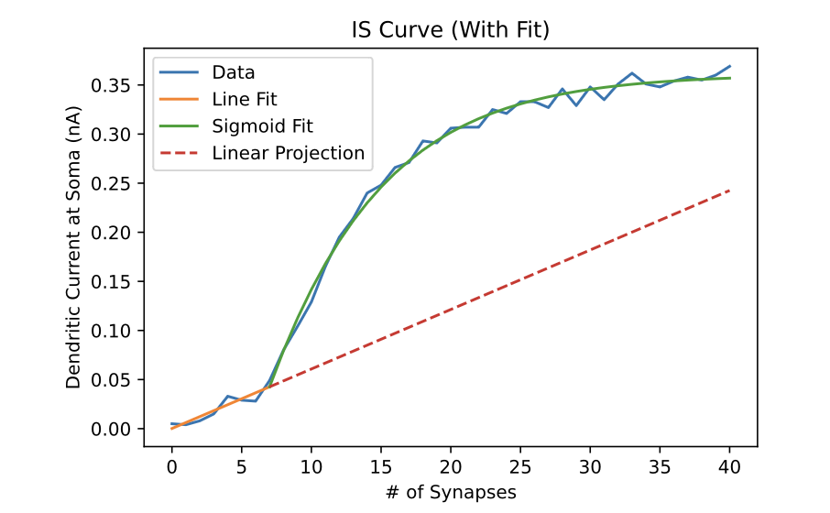
CASE 1: ½ Synapses on Soma, ½ Synapses at Excitatory Distance (139 µm)

Slide 5
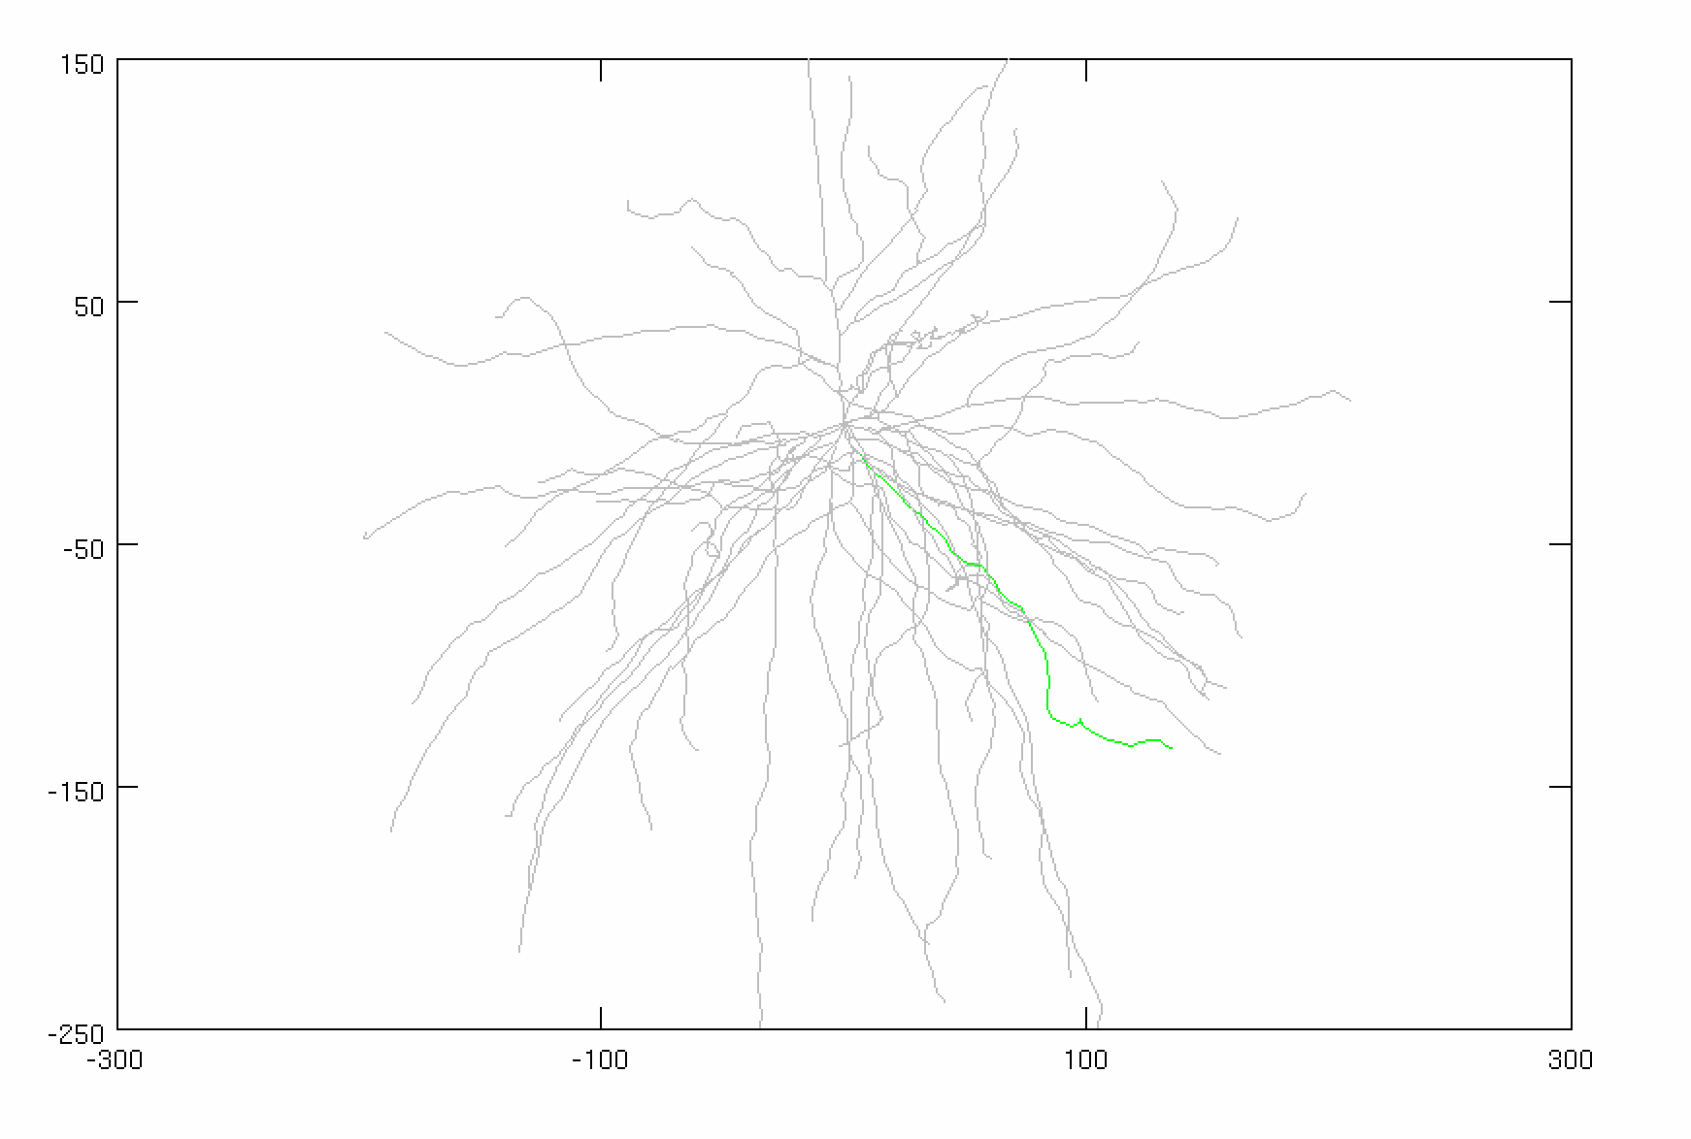
CASE 2: All Synapses on Soma
Background Inhibitory Synapses
Total synapses: 30 synapses
Firing rate: 50 Hz
Distribution: 3 ms
Conductance: 0.005 µS
Adjusted Current
Amplitude: 1.875 nA
Noise: 0 nA

Slide 6
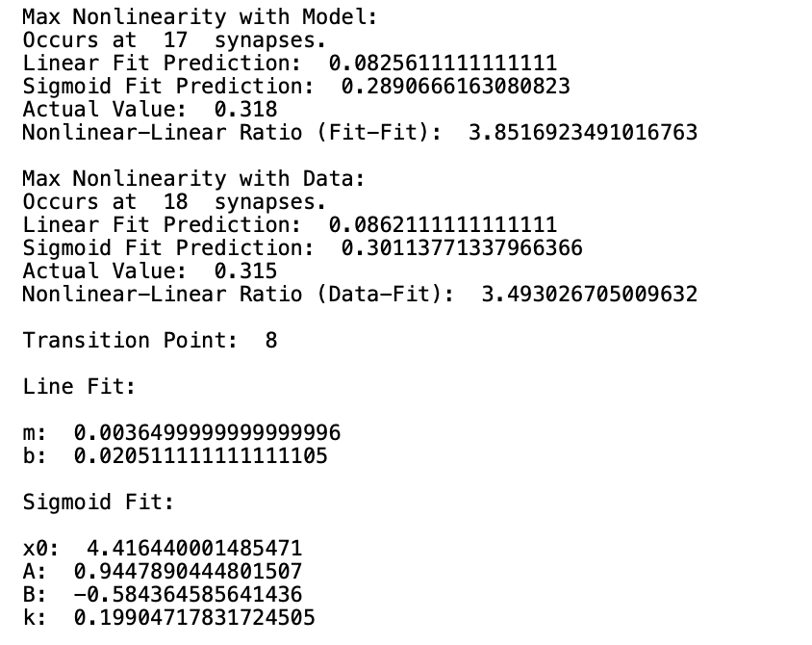
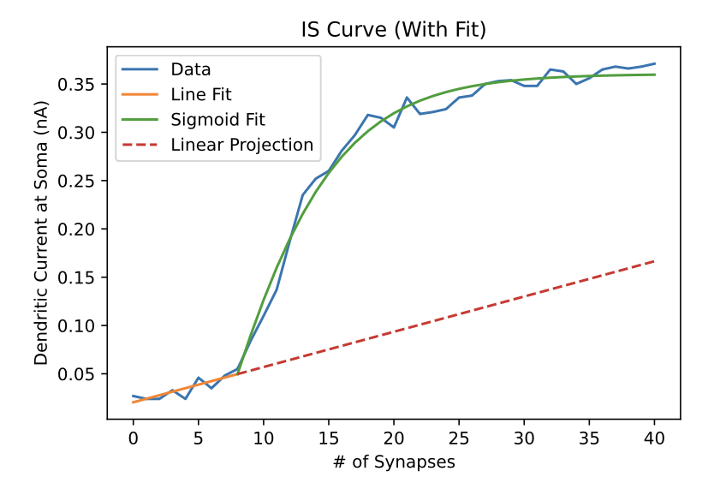
CASE 2: All Synapses on Soma

Slide 7
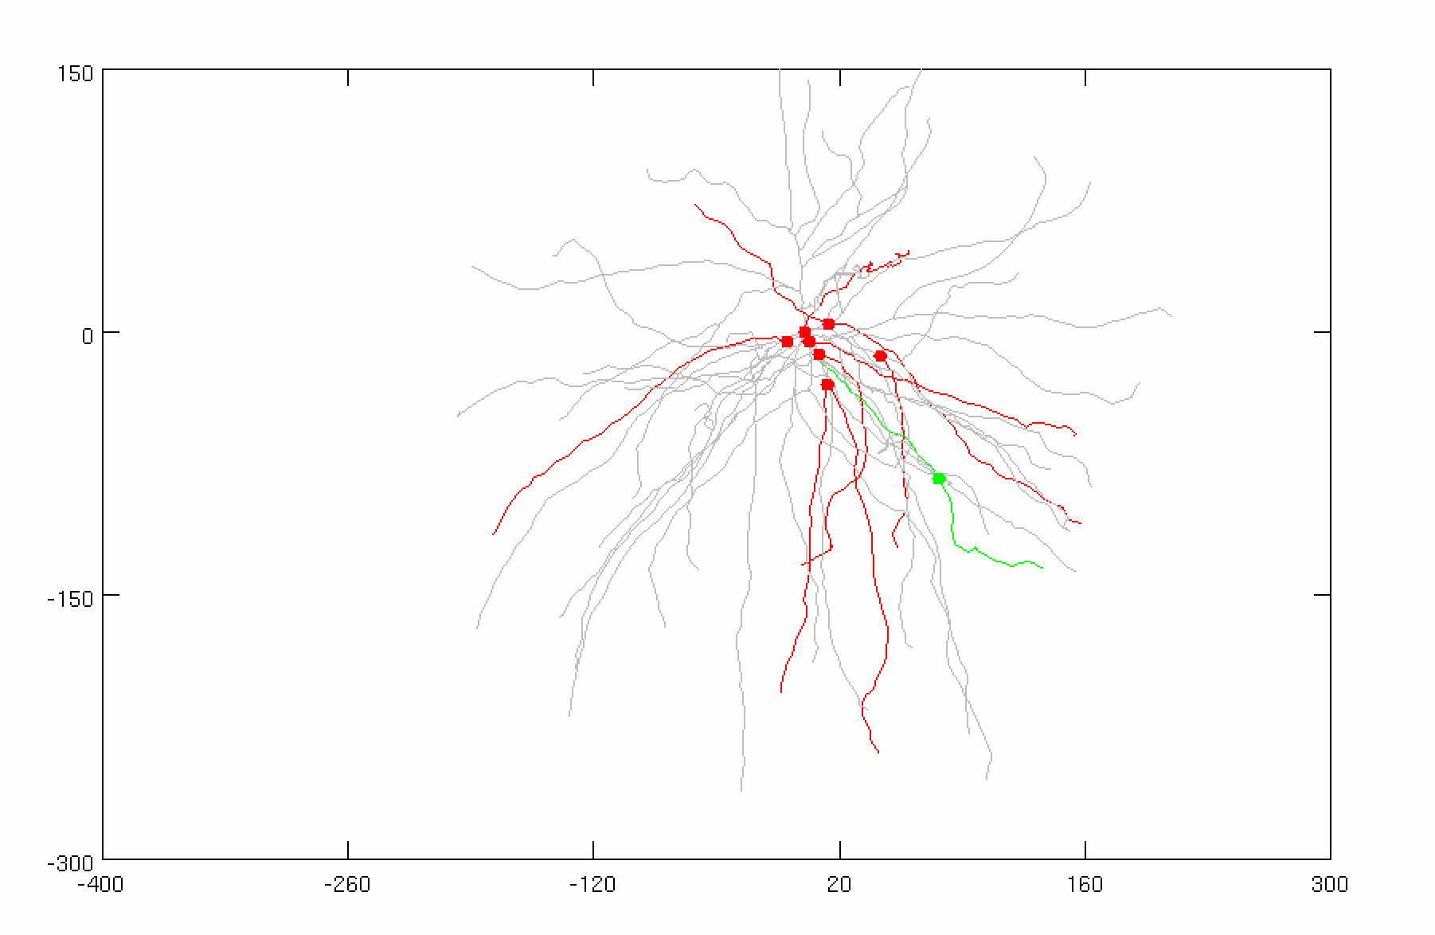
CASE 3: ½ Synapses on Soma, ½ Synapses at 20 µm
Background Inhibitory Synapses
Total synapses: 30 synapses
Firing rate: 50 Hz
Distribution: 3 ms
Conductance: 0.005 µS
Adjusted Current
Amplitude: 1.46 nA
Noise: 0 nA

Slide 8
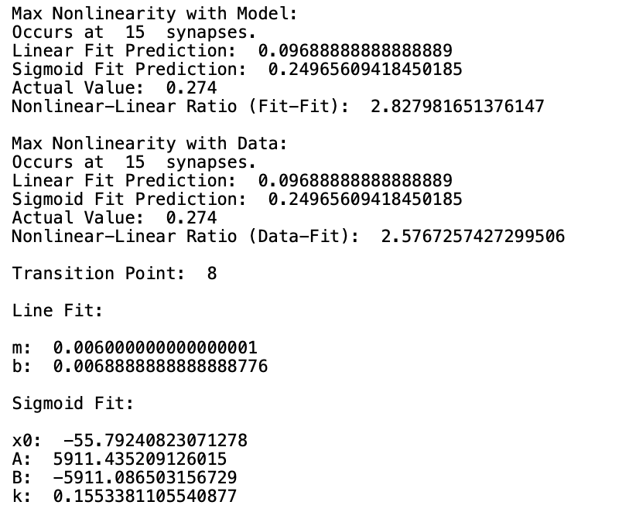
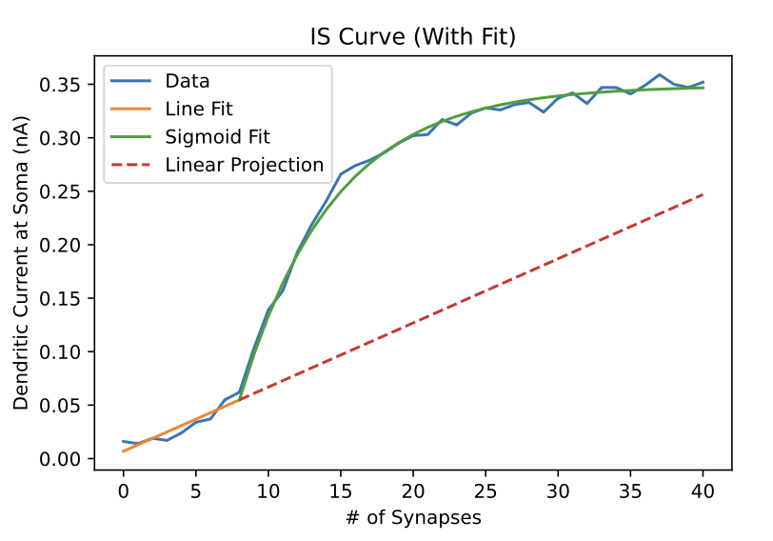
CASE 3: ½ Synapses on Soma, ½ Synapses at 20 µm

